Slide 1

Adhyayan NextGen Solutions Pvt. Ltd.
Expertise: Website & Software Development, Cloud Solutions, Cybersecurity
Services: School ERP |Inventory| CRM Software | Website & App Development
Office locations:
Head Office: Gurugram, Haryana
Branch Office: Neelbad, Bhopal

Slide 2


Adhyayan NextGen Solutions Pvt. Ltd.
Attendance System Overview
Mark Attendance Only Within Allowed Campus Radius
Attendance allowed on one device
verify attendance anytime anywhere
Actual In-Out Time Tracking
Monitor report anytime anywhere

Slide 3
Adhyayan NextGen Solutions Pvt. Ltd.
Why Choose Us?
Decades Of Experience In IT Solutions
Latest Technology and Tech Trends
Customize Solutions
Consistent Update And Maintenance Services
Cloud Based ERP CRM Software Services

Slide 4
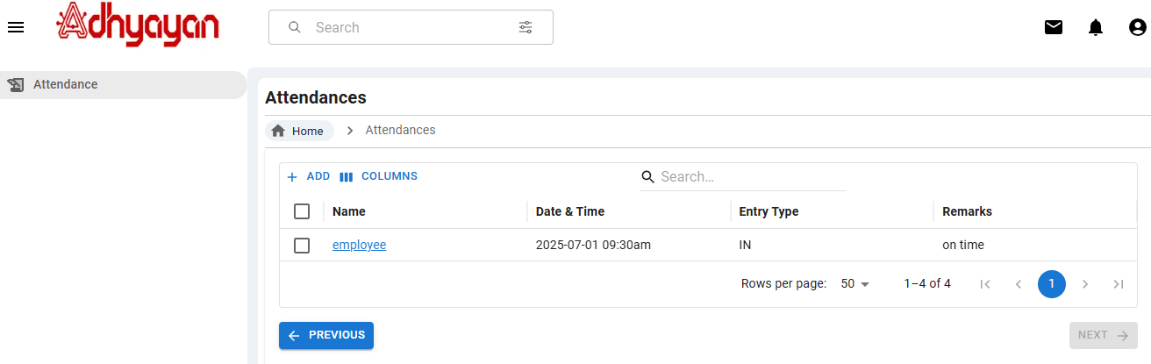
Adhyayan NextGen Solutions Pvt. Ltd.
Employee Dashboard - Attendance

Slide 5
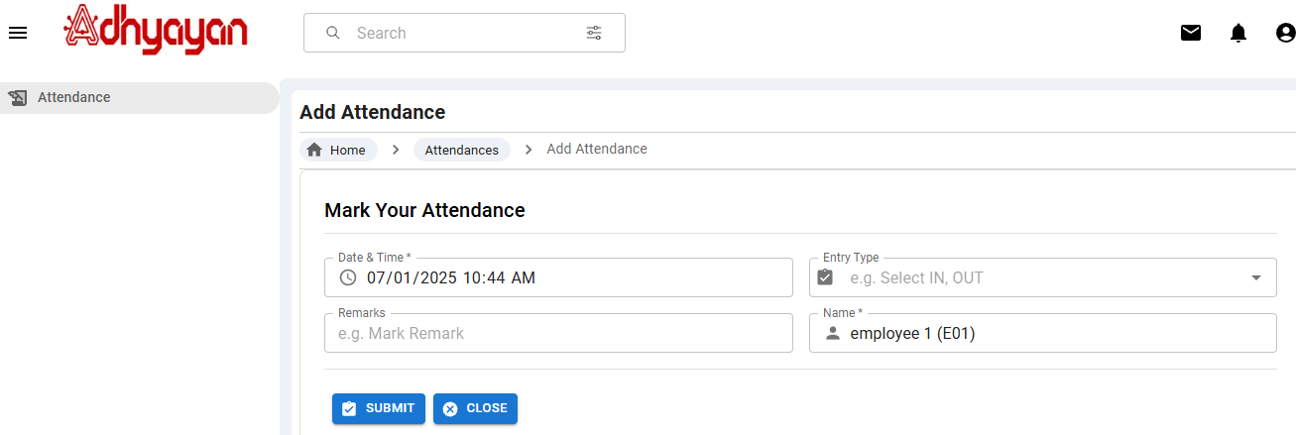
Adhyayan NextGen Solutions Pvt. Ltd.
Employee Dashboard - Attendance

Slide 6
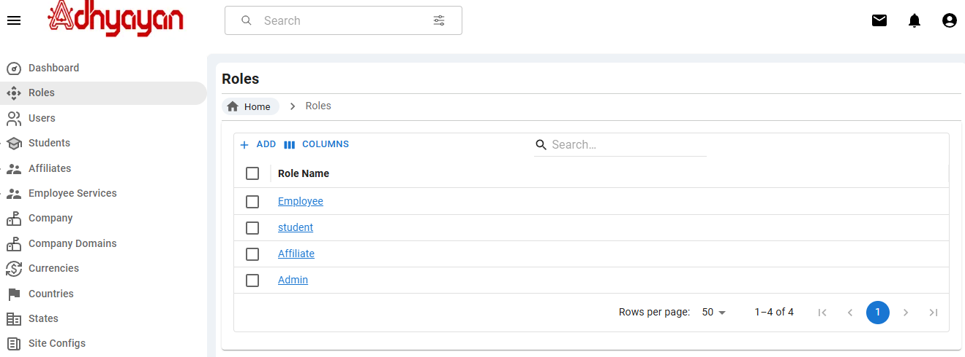
Adhyayan NextGen Solutions Pvt. Ltd.
Admin Dashboard-Roles

Slide 7
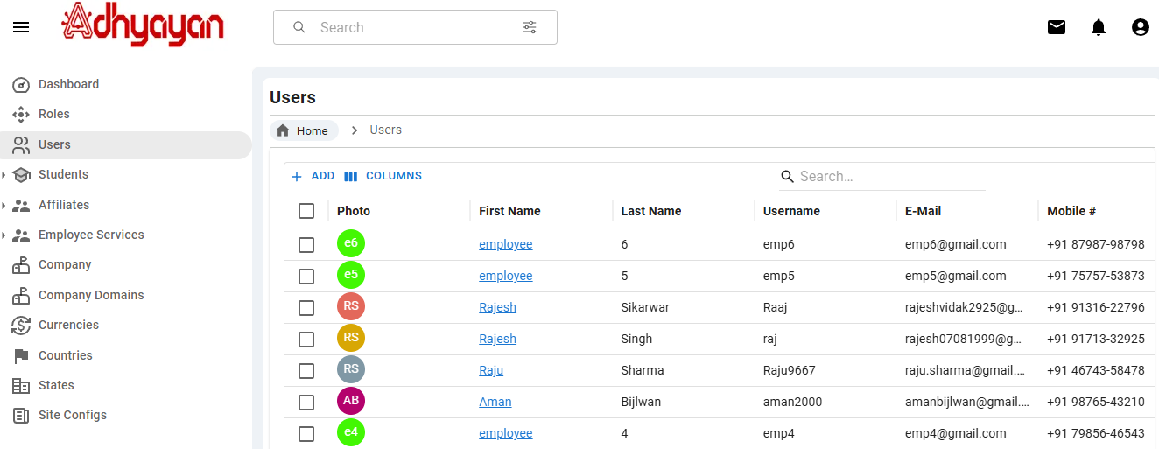
Adhyayan NextGen Solutions Pvt. Ltd.
Admin Dashboard - Users

Slide 8
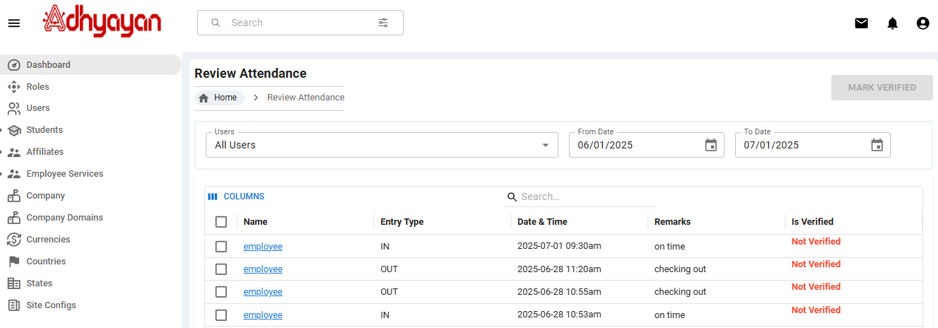
Adhyayan NextGen Solutions Pvt. Ltd.
Admin Dashboard - Review Attendance

Slide 9
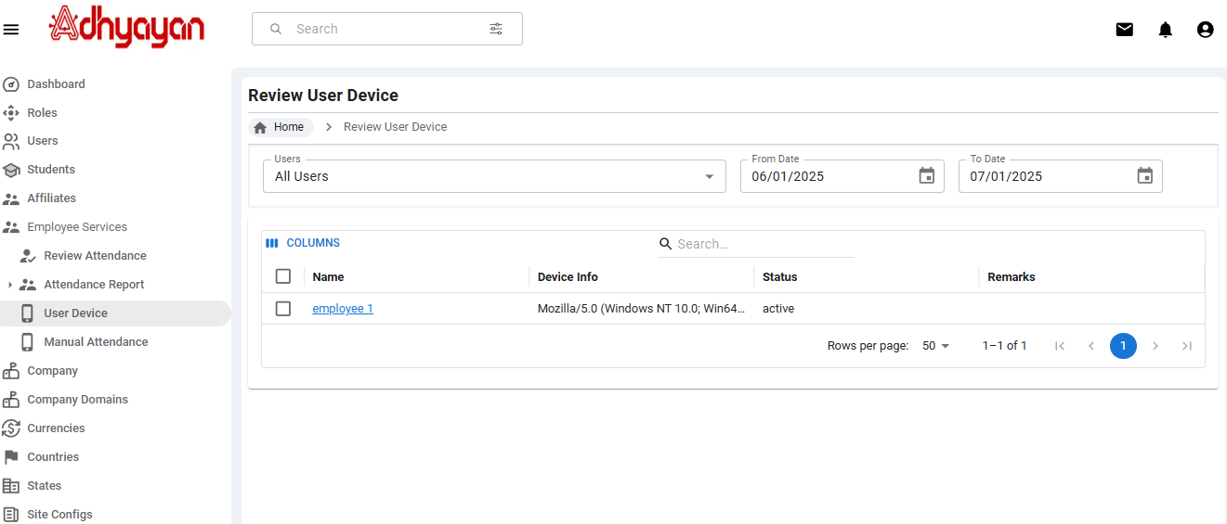
Adhyayan NextGen Solutions Pvt. Ltd.
Admin Dashboard - User Device

Slide 10
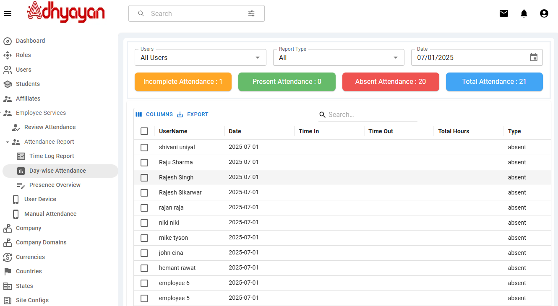
Adhyayan NextGen Solutions Pvt. Ltd.
Admin Dashboard – Day-wise attendance

Slide 11
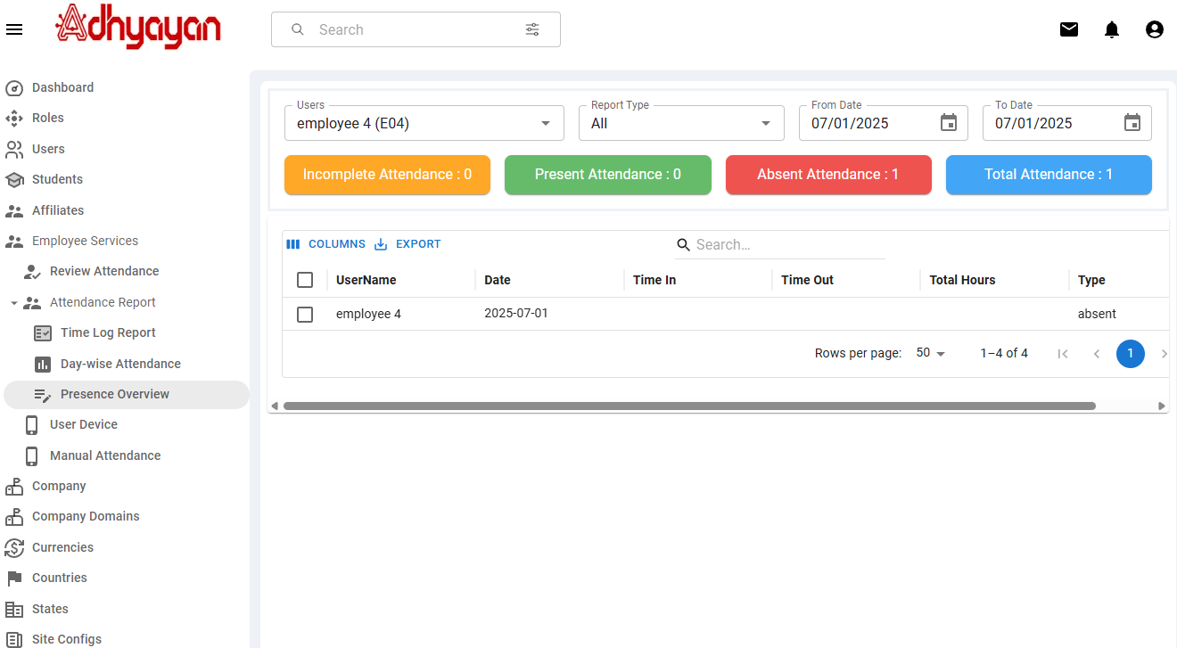
Adhyayan NextGen Solutions Pvt. Ltd.
Admin Dashboard – Presence Overview

Slide 12
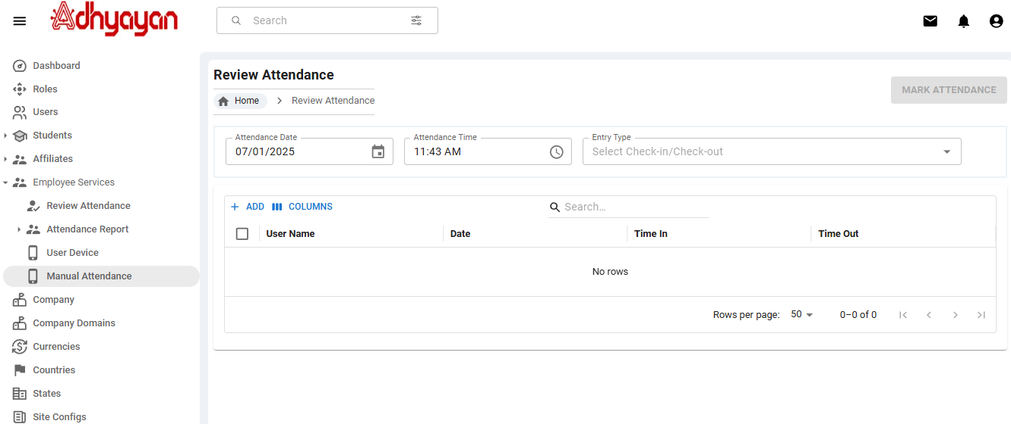
Adhyayan NextGen Solutions Pvt. Ltd.
Admin Dashboard – Manual Attendance
User Manual

Slide 13
Adhyayan NextGen Solutions Pvt. Ltd.
Thank You

